Slide 1

Sae – aero micro capstone
Yaqoub Almounes – Budget Liason
John Cowan – Website Developer
Josh Gomez – Project Manager
Mohammad Qasem – Document Manager
Michael Medulla – Client Contact

Slide 2
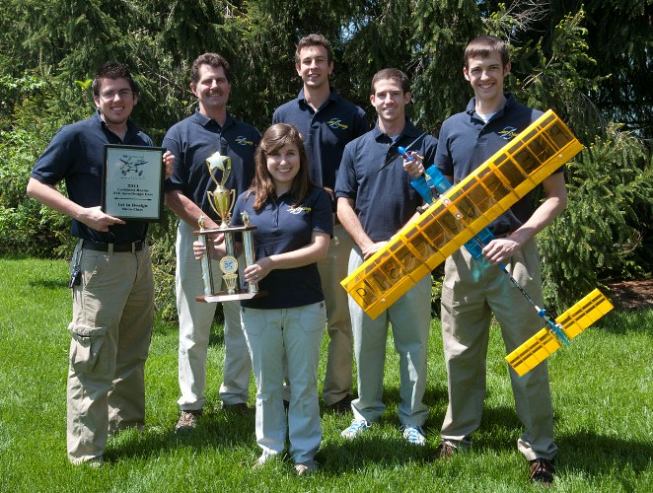
Project Description
SAE International holds annual Collegiate Aero Design competition
Universities from around the world showcase aircraft designs of various sizes to convey use of resources and efficient design
Micro class required to design a radio controlled aircraft which carries the highest payload fraction possible, while maintaining lowest empty weight possible.
Judges score each design based on written report, oral presentation, flight results.
Figure 1: Cedarville SAE Aero Design Team[1]

Slide 3
Designs Considered
Concept | Wing | Airfoil | Material | Motor | Propeller | Body
1 | High | Normal/ Flat bottom | Foam | Single Brushless | 2 Prop | Carbon Fiber
2 | Flaps | Normal | Foam | Twin Brushless | 2 Prop | Square
3 | Expandable | Straight Flat bottom | Monokote | Single Brushless | 2 Prop | Carbon Fiber
4 | Delta Wing | Straight Flat Bottom | Balsa Wood | Twin Brushless | 3 Prop | Square
5 | Biplane | Clark Y-14 | Foam | Single Brushless | 3 Prop | Carbon Fiber

Slide 4
Designs Considered
Concept | Advantages | Disadvantages
1 | -Greater Lift/ Stability Lightest | -Flexible -Low Power
2 | -Greater Lift when deployed | -Must be deployed for extra lift -Square body not aerodynamic
3 | -Fits size constraint | -Can collapse -Possibly too light
4 | -High speed -Twin motors provide more thrust | -May not fit size constraint -Heavy
5 | -Stable -High lift | -Greater drag -Heavy

Slide 5
Design Selection
Delta Wing and Biplane eliminated based on disadvantages
Twin Brushless Motor and square body are too heavy and create more drag
Monokote viable, but creates more weight
Flaps control angle of attack. Allows for optimal lift.
High wing creates more lift due to placement and glides well if motor fails
Carbon fiber body is lighter than the square body
Foam is light and durable
Final Selection: Concept 1
High Wing/Flaps | Flat Bottom Airfoil | Foam Material | Single Brushless Motor | 2 Blade Propeller | Carbon Fiber Body

Slide 6
Designs Selection
Customer Requirements | Weighting (1 most important, 5 least important) | Rating for design selected (1-10, 10 is best)
Safety | 1 | 8
High Payload Fraction | 1 | 10
Durable | 1 | 7
Lightweight | 1 | 10
Maximum Lift | 1 | 10
Payload Bay | 1 | 10

Slide 7
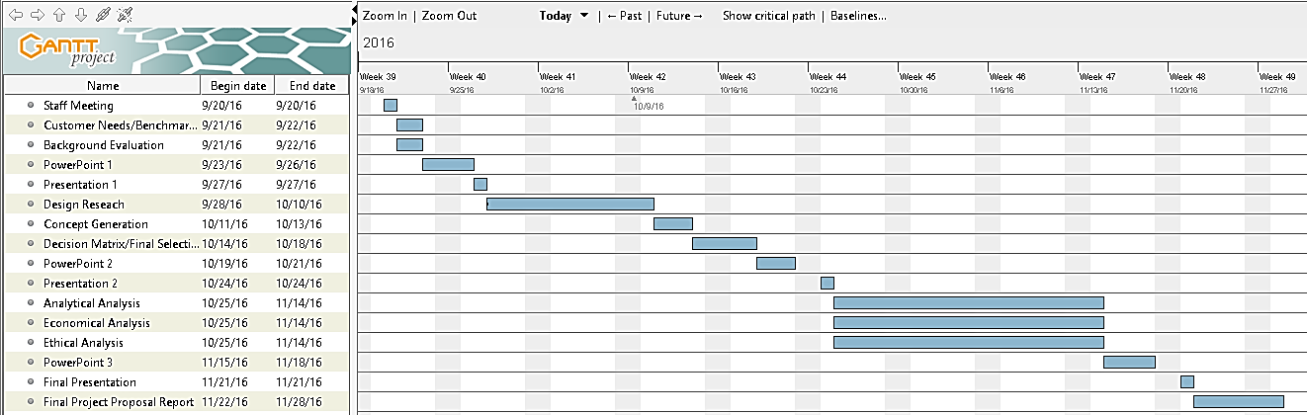
Schedule

Slide 8
budget
 | Quantity | Price
Registration | 1 Time payment | $1,000
ESC Controller | 1 | $20
Brushless Motor | 1 | $25
Foam Sheet (4x8) | 1 | $15
Carbon Fiber Rods | 2 | $15 x 2 = $30
Carbon Fiber Tube | 1 | $15
Servos | 4 | $5 x 4 = $20
Prop | 1 | $5
Cables | 4 | $2 x 4 = $8
Pushrods | 4 | $2 x 4 = $8
Transmitter | 1 | $150
Set of Hinges (15) | 1 | $4
Control Horns Set | 1 | $5
Firewall/ Engine Mount | 1 | $5
Miscellaneous | TBD | $20
Total Spent |  | $1,330

Slide 9
References
[1] “Aero Design Team Soars to Success at Competition” Cedarville University,c 2011 [Online] Available: http://www.cedarville.edu/Offices/Public-Relations/CampusNews/2011/Aero-Design-Competition.aspx

Slide 10
Thank you

